Slide 1
Starting Individual Interviews in CAPI

Slide 2




Steps …
From main interviewer menu, choose “Menu for eligible individuals”
Choose household where person lives; then choose person to interview
Choose “result” of interview and administer consent
Begin interview!

Slide 3
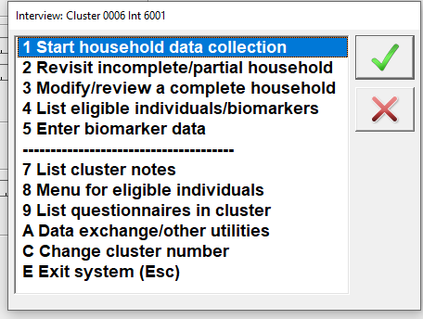
Menu for eligible individuals

Slide 4
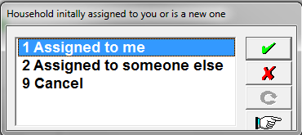
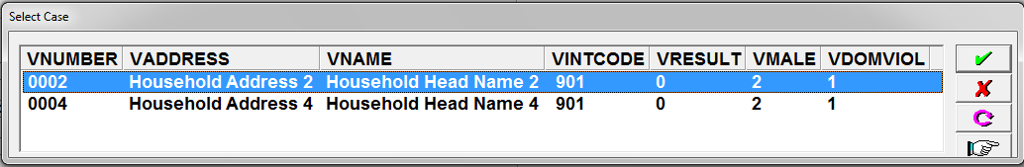
Choose woman to interview
First, locate HH in which individual lives:
Was the HH:
Assigned to you? (1)
Assigned to a teammate? (2)
Choose correct household:
Result code should be 1
Notes:
ASK: What must the result code be (far right on household list) to do a woman’s interview?

Slide 5
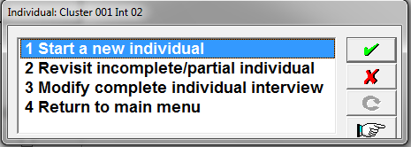
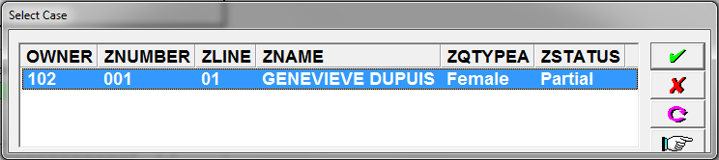
Choose individual to interview
Second, choose individual to interview:
Is the person a:
New individual? (1)
Individual started, but not completed? (2)
OR a call-back? (2)
Complete individual to modify? (3)
Choose individual from list:
Notes:
ASK: Why might a woman you want to interview not be shown?
Answer: You might have picked the wrong household where she lives (or wrong cluster even!); she might not be eligible

Slide 6
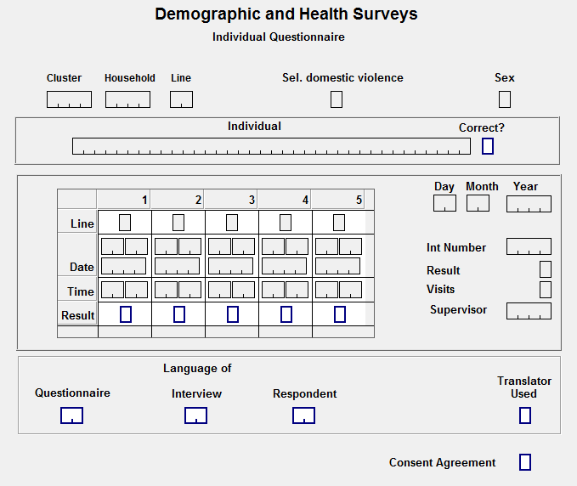
Complete cover page
ID information
Woman’s name
Visits information
All automatically populated
Notes:
Note that there have been more than one visit for this woman!

Slide 7
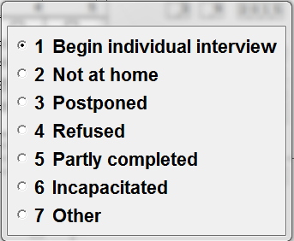
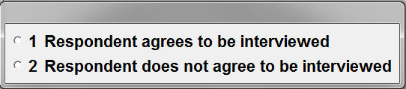
Complete cover page
Choose “result” of the visit:
Choose result of consent:
Notes:
ASK: which code is call back? ASK: what are examples of incapacitated?

Slide 8
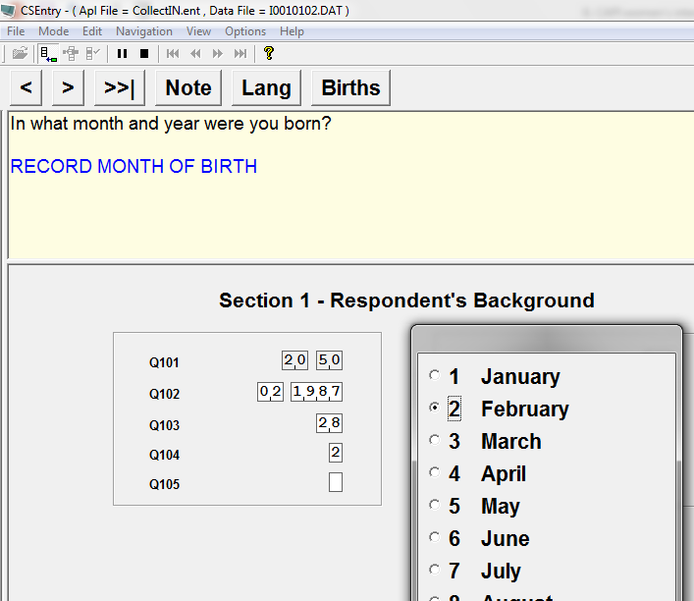
Begin Individual Interview!!
Buttons
Questions, instructions
Black – read out loud respondent
BLUE – instructions for interviewer
Red – actions for interviewer
Notes:
Buttons – navigation (one at a time, or to last question (F10) ); add a note at anytime (highly encouraged); change language; see list of births in birth history (only available after entering it…….

Slide 9

Exercise
Individual interview demonstration
Demonstration of CAPI entry with mock interview
Interviewers enter in their system
Using own FIRST household assigned (which should have an eligible individual!)
1
Notes:
Content expert will go over HW answers – CAPI expert will demo entry on their computer
Interviewers will then enter HW
Ask interviewers to identify their first woman in a HH “assigned to me” – via demo on your computer
Things to make sure to note during entry of woman – which is done with demo on facilitator laptop while class follows along on their tablets:

